Slide 1
A Look at the New Science Standards
The New Science Standards will go into effect in the 2018-2019 School Year.
August 8, 2017

Slide 2
Ideas Driving the Development of the Standards are:
Improve the coherence of the content from grade to grade.
Integrate disciplinary core ideas with crosscutting concepts and science and engineering practices.
Promote equity and diversity of science and engineering education for all learners.

Slide 3
A Look at the
Three Dimensions
The Science and Engineering Practices (SEP)
The Cross Cutting Concepts (CCC)
The Disciplinary Core Ideas (DCI)

Slide 4
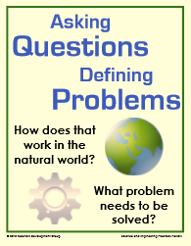
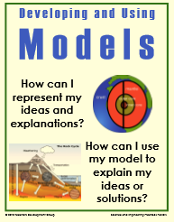
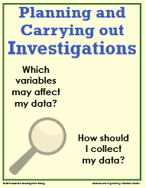
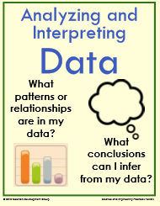
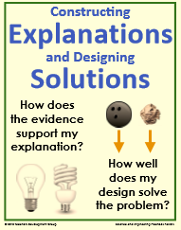
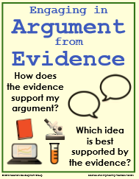
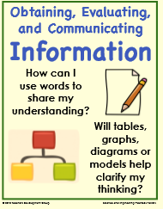
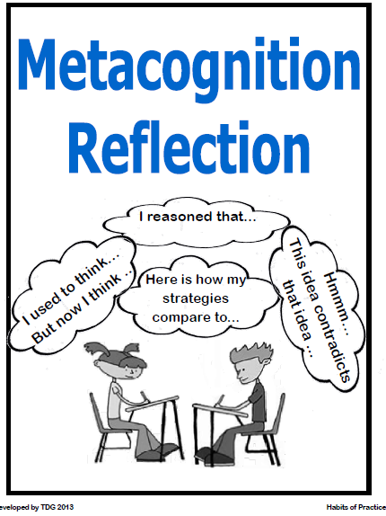
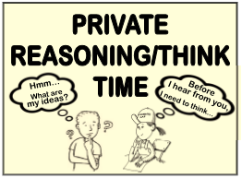
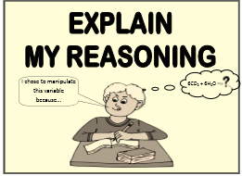
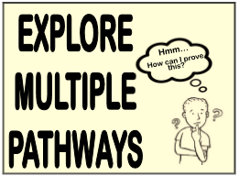
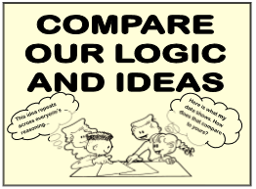
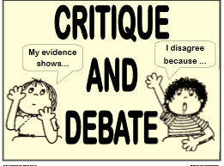
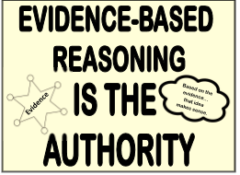
Develop Solutions to Complex Problems
Investigate
Evaluate
Develop Explanations
Notes:
The science and engineering practices are used as a means to learn science by doing science, thus combining knowledge with skill. The goal is to allow students to discover how scientific knowledge is produced and how engineering solutions are developed. The following practices should not be taught in isolation or as a separate unit, but rather differentiated at each grade level from K-12 and integrated into all core ideas employed throughout the school year. These are not to be taught in isolation but are embedded throughout the language of the standards.

Slide 5
Cross Cutting Concepts (CCC)
These are concepts that permeate all science and show an interdependent connection among the sciences differentiated from grades K-12. Tennessee state science standards have explicitly designed the standard progression to include these crosscutting concepts:
Pattern observation and explanation
Cause and effect relationships that can be explained through a mechanism
Scale, proportion, and quantity that integrate measurement and precision of language
Systems and system models with defined boundaries that can be investigated and characterized by the next three concepts
Energy and matter conservation through transformations that flow or cycle them into, out of, or within a system
Structure and function of systems and their parts
Stability and change of systems

Slide 6
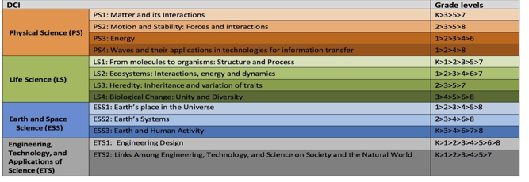
Disciplinary Core Ideas (DCI)
Notes:
Disciplinary Core Ideas and Components: The Framework for K-12 Science Education describes the progression of disciplinary core ideas (DCIs) and gives grade level end points. These core ideas and the component ideas are the structure and organization of the Tennessee Academic Standards for Science. Focusing on a limited number of ideas, grades K-12 will deepen content knowledge and build on learning. The progressions are designed to build on student understanding of science with developmental appropriateness.

Slide 7
Mathematical and Literacy Skills for Science Proficiency
Reading
Vocabulary
Speaking and Listening
Writing
Notes:
These are the same as the Literacy Skills for Math

Slide 8
Mathematical and Literacy Skills for Science Proficiency
Take a few moments of Private Think Time to read the Literacy Skills for Science Proficiency
Small Group Discussion:
- What stood out to you the most?
- What are some strategies that you use to
develop these skills in your students?
Notes:
These are the same as the Literacy Skills for Math

Slide 9
Looking Ahead to the Transition
What work is most critical for us to successfully transition to the
new standards?
Notes:
These are the same as the Literacy Skills for Math

