Slide 1
Welcome to HCDE System Wide Professional Learning
Tuesday, August 8, 2017

Slide 2
Welcome and Icebreaker
Name
School
One thing that makes you bitter!
(does not have to be school related)

Slide 3
Agenda for the Day
Welcome
Morning- Grade Level
HOP Review
Productive Engagement
Solar Lesson
New Standards
Lunch
Afternoon- Vertical
Tasks, Questions, Discourse-
New Teacher Meeting @ 3:00
New to district or teaching

Slide 4
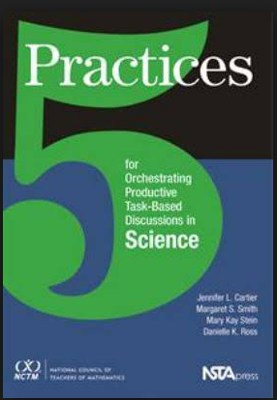
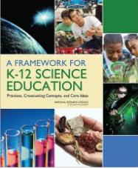
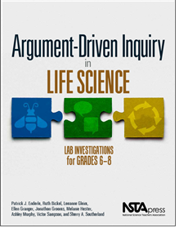
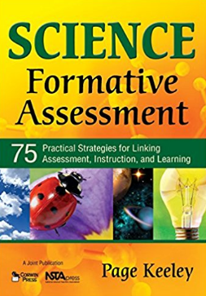
Resource Review

Slide 5
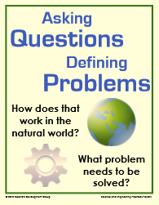
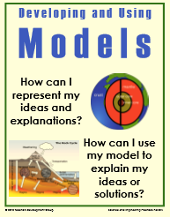
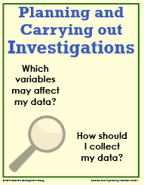
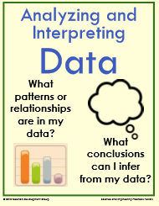
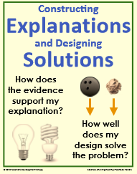
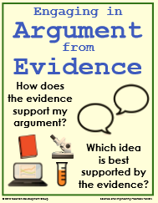
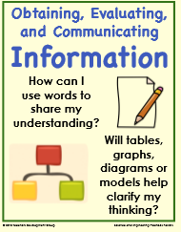
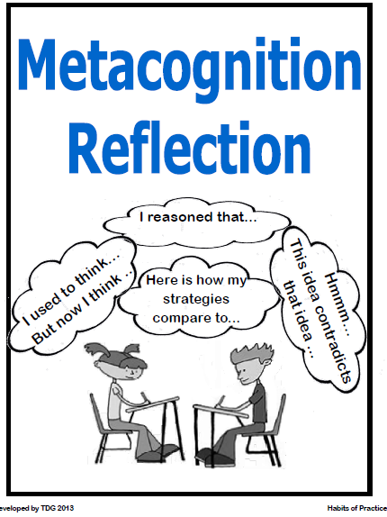
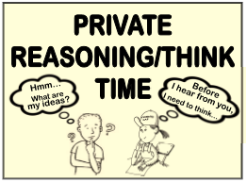
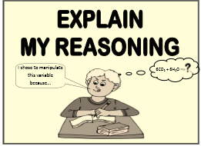
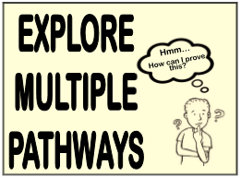
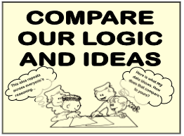
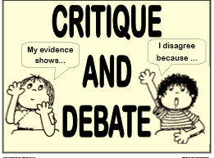
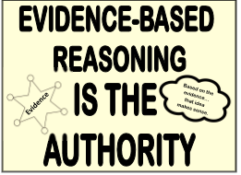
The Habits -Interaction & Practice
Notes:
The science and engineering practices are used as a means to learn science by doing science, thus combining knowledge with skill. The goal is to allow students to discover how scientific knowledge is produced and how engineering solutions are developed. The following practices should not be taught in isolation or as a separate unit, but rather differentiated at each grade level from K-12 and integrated into all core ideas employed throughout the school year. These are not to be taught in isolation but are embedded throughout the language of the standards.

Slide 6
Habits of Practice
PRT/PTT for a short read
-As you read, think about the following questions:
Which HoP’s you incorporate or try to incorporate in your own practice? Why?
Which ones do you not use as much? Why?

Slide 7
Habits of Practice
Move to a HoP posted in the room, mark on the continuum 0 to 4 where you are in your practice. Move to open HoP’s as they are vacated.

Slide 8
Hcde Productive Engagement
Engagement vs. Productive Engagement
Productive Engagement as defined by you and your peers

Slide 9
Hcde Productive Engagement

Slide 11
The Great American Solar Eclipse
August 21, 2017
HCDE
Secondary Science

Slide 12
The Simpsons- Mr. Burns’ Eclipse

Slide 13
Focus Question (s):
What causes both a total and partial eclipse? How does location affect what you see?

Slide 14
Modeling a Solar Eclipse
3 Volunteers?
1- Sun
1- Earth
1- Moon

Slide 15
Making an eclipse Happen
Materials
- Flashlight
- Meter stick
- 1” (2.5cm) ball on a toothpick/paperclip (Earth model)
- ¼" (7 mm) bead on a toothpick/paperclip (Moon model)
- Binder clips to attach toothpicks to the yard/meter stick 30 inches (75 cm) apart

Slide 16
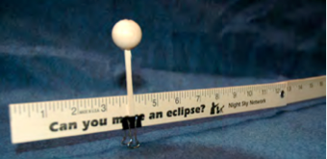
Making an eclipse Happen
Try to move Moon-bead into Earth-bead’s shadow and make a lunar eclipse.

Slide 17
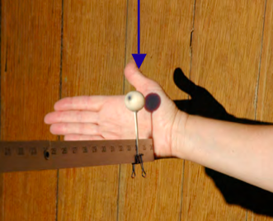
Making an eclipse Happen
Let’s make a solar eclipse. Try to align the Moon-bead toward the Sun and cast a shadow on the Earth bead. (The arrow in the photo is pointing to the Moon’s shadow on the Earth ball.)

Slide 18
Simulations
https://eclipsemega.movie/simulator?lat=35.137265&lng=-85.2368219
https://www.nasa.gov/feature/goddard/2016/preparing-for-the-august-2017-total-solar-eclipse

Slide 19
Interactive Map
https://eclipse2017.nasa.gov/sites/default/files/interactive_map/index.html

Slide 20
Solar Eclipses for Beginners
Reading: Solar Eclipses for Beginners Fred Espenak (©2009)

Slide 21
Video Resource
While watching the video, try to answer the focus question(s).
https://www.youtube.com/watch?v=IQIahbc7oas

Slide 22
Create an Artifact
Question (what are you trying to answer- What causes both a total and partial eclipse? How does location affect what you see?)
Claim (what your answer is)
Evidence (what proof do you have your claim is correct)
Reasoning/Justification (what makes your evidence good)

Slide 23
How to Make a Pin Hole Camera
Materials
Two pieces of white paper (or cardstock),
A 2-3” square of aluminum foil
Tape
A pin or paperclip

Slide 24
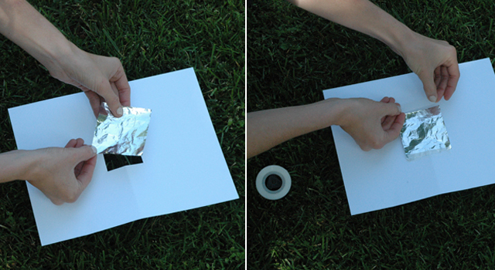
How to Make a Pin Hole Camera
Cut a square hole in one piece of paper
Tape the square of aluminum foil over the hole

Slide 25
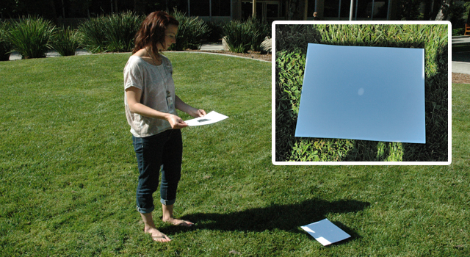
How to Make a Pin Hole Camera
Poke a hole in the foil
Try it out!

Slide 26
Problems with Viewing the Eclipse…
Retina Damage due to excessive exposure to direct sunlight

Slide 27
Eclipse Safety
Article:
How to View the 2017 Solar Eclipse Safely

Slide 28
Eclipse Safety Nasa Video

Slide 29
Online Resources
https://eclipse2017.nasa.gov/
http://thetsin.org/news/2017/eclipse/
http://www.mreclipse.com/

Slide 30
A Look at the New Science Standards
The New Science Standards will go into effect in the 2018-2019 School Year.
August 8, 2017

Slide 31
Ideas Driving the Development of the Standards are:
Improve the coherence of the content from grade to grade.
Integrate disciplinary core ideas with crosscutting concepts and science and engineering practices.
Promote equity and diversity of science and engineering education for all learners.

Slide 32
A Look at the
Three Dimensions
The Science and Engineering Practices (SEP)
The Cross Cutting Concepts (CCC)
The Disciplinary Core Ideas (DCI)

Slide 33
Develop Solutions to Complex Problems
Investigate
Evaluate
Develop Explanations
Notes:
The science and engineering practices are used as a means to learn science by doing science, thus combining knowledge with skill. The goal is to allow students to discover how scientific knowledge is produced and how engineering solutions are developed. The following practices should not be taught in isolation or as a separate unit, but rather differentiated at each grade level from K-12 and integrated into all core ideas employed throughout the school year. These are not to be taught in isolation but are embedded throughout the language of the standards.

Slide 34
Cross Cutting Concepts (CCC)
These are concepts that permeate all science and show an interdependent connection among the sciences differentiated from grades K-12. Tennessee state science standards have explicitly designed the standard progression to include these crosscutting concepts:
Pattern observation and explanation
Cause and effect relationships that can be explained through a mechanism
Scale, proportion, and quantity that integrate measurement and precision of language
Systems and system models with defined boundaries that can be investigated and characterized by the next three concepts
Energy and matter conservation through transformations that flow or cycle them into, out of, or within a system
Structure and function of systems and their parts
Stability and change of systems

Slide 35
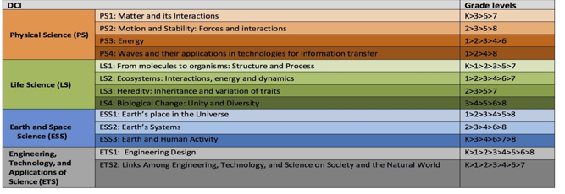
Disciplinary Core Ideas (DCI)
Notes:
Disciplinary Core Ideas and Components: The Framework for K-12 Science Education describes the progression of disciplinary core ideas (DCIs) and gives grade level end points. These core ideas and the component ideas are the structure and organization of the Tennessee Academic Standards for Science. Focusing on a limited number of ideas, grades K-12 will deepen content knowledge and build on learning. The progressions are designed to build on student understanding of science with developmental appropriateness.

Slide 36
Mathematical and Literacy Skills for Science Proficiency
Reading
Vocabulary
Speaking and Listening
Writing
Notes:
These are the same as the Literacy Skills for Math

Slide 37
Mathematical and Literacy Skills for Science Proficiency
Take a few moments of Private Think Time to read the Literacy Skills for Science Proficiency
Small Group Discussion:
- What stood out to you the most?
- What are some strategies that you use to
develop these skills in your students?
Notes:
These are the same as the Literacy Skills for Math

Slide 38
Looking Ahead to the Transition
What work is most critical for us to successfully transition to the
new standards?
Notes:
These are the same as the Literacy Skills for Math

Slide 39
Lunch
We will meet in Vertical Groups at 1:00 this afternoon
Tasks
Discourse
Questions

Slide 41
Please take PRT/PTT
to acquaint yourself
with the questioning resources provided.

Slide 42
Tips for Developing Scientific Thinking with Effective Questions
To promote problem solving, ask…
To help students learn to reason scientifically, ask..
To check student progress, ask…
To help when students get stuck, ask…
To help students collectively make sense, ask…
To encourage conjecturing, ask…
To encourage reflection, ask
???
Notes:
This is a group jigsaw activity. Groups will use chart paper to document the types of questions for each section. After whole discussion, give out PBS handout.

Slide 43
Asking Questions
May be:
Driven by curiosity
Result from predictions of a model
Spring from previous investigations
Should emerge from empirical evidence
- Leads to other scientific practices!

Slide 44
For students, the ability to ask clearly defined questions is ESSENTIAL.

Slide 45
What does the authentic practice of questioning LOOK like & SOUND like in your classroom?
Notes:
Allow PTT and 1-2 minutes of whole group share out

Slide 46
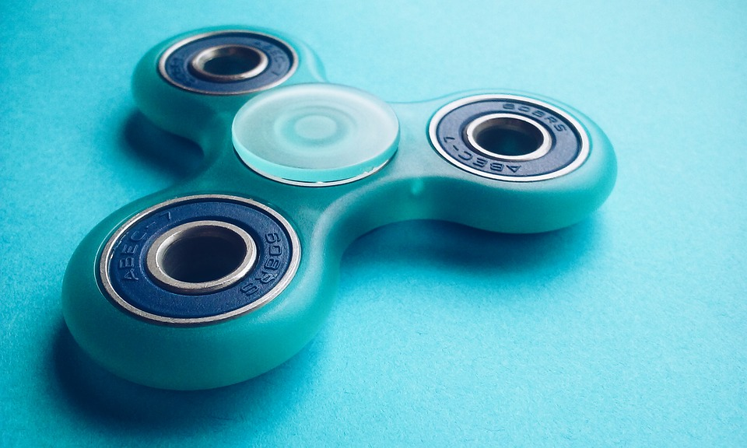
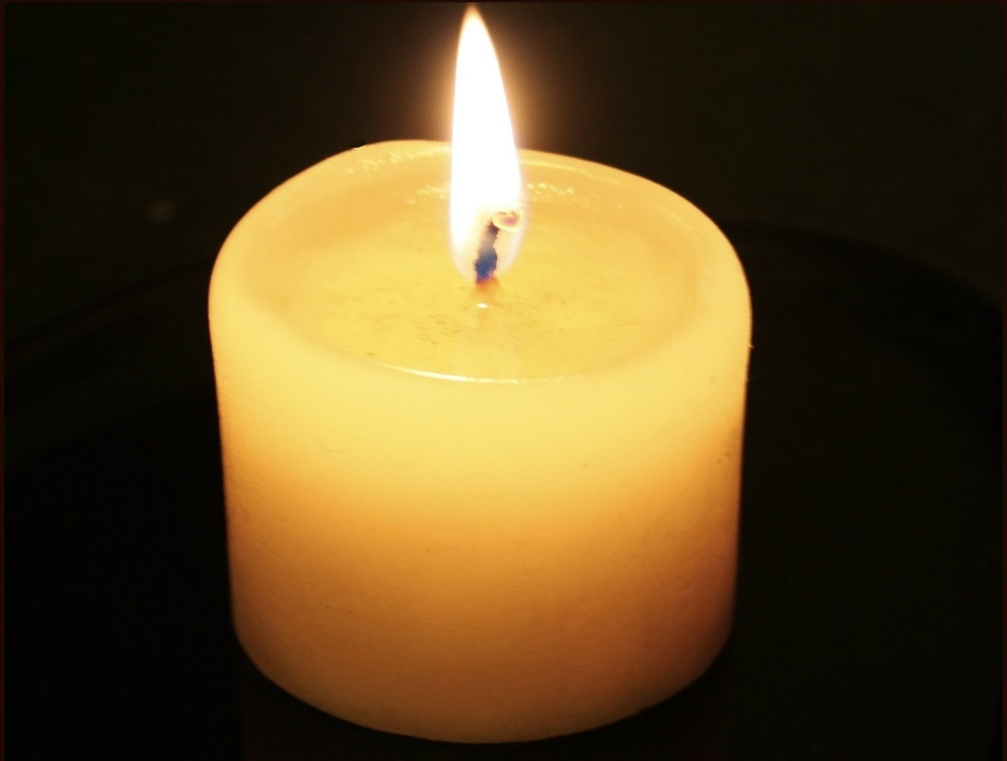
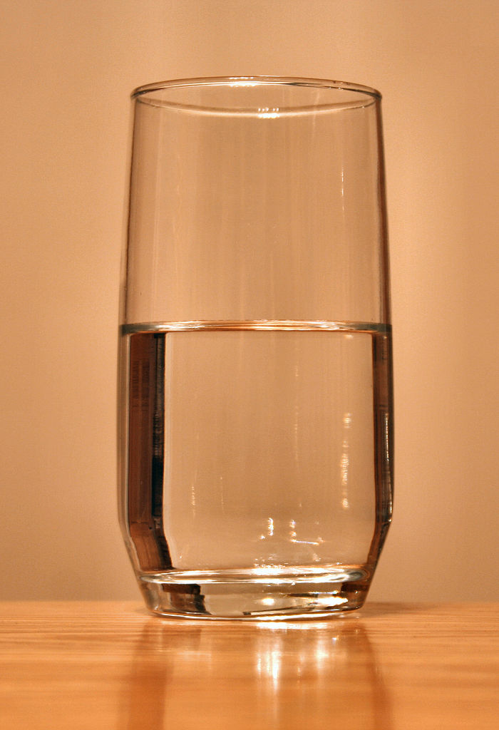

Slide 47
Question Activity Instructions:
Split into 2 groups:
Group 1 - Teacher Probing Questions
Group 2 - Student Design Questions
You will have ____ minutes to decide on questions to share with the whole group based on the video.

Slide 48
Science & Engineering Practices
What do science questions sound like in comparison to engineering questions?
Notes:
First page of the NGSS@NSTA packet. Have Readers create a T-Chart to share out….

Slide 49
Asking Questions and Defining Problems
Science
Begins with a question about a phenomenon
Basic practice is the ability to formulate empirically answerable questions
These questions:
Establish what is already known
Determine what questions have yet to be answered
Engineering
Begins with a problem that needs to be solved
Basic practice to ask questions to clarify the problem
These questions also:
- Determine criteria for a successful solution
- Identify constraints
Notes:
From the Scientific and Engineering Practices in the K-12 Classrooms article

Slide 50
Evaluations
Please turn in your evaluations!
If you are a new teacher (New to Science or the District), please attend the New Science Teacher Meeting.

