Slide 1
HAMILTON COUNTY’S PROFESSIONAL LEARNING FOR THE 2016-2017 SCHOOL YEAR Please get your cell phones out and text _____________ to _______________. AUGUST 2016 SESSION
WELCOME TO
Notes:
Slide 1: Opening Visual
Welcome teachers as they enter.
Teachers in mixed groups of schools and grade/course levels.
Pass out Evaluations.
Start on time! Introduce yourself.

Slide 2
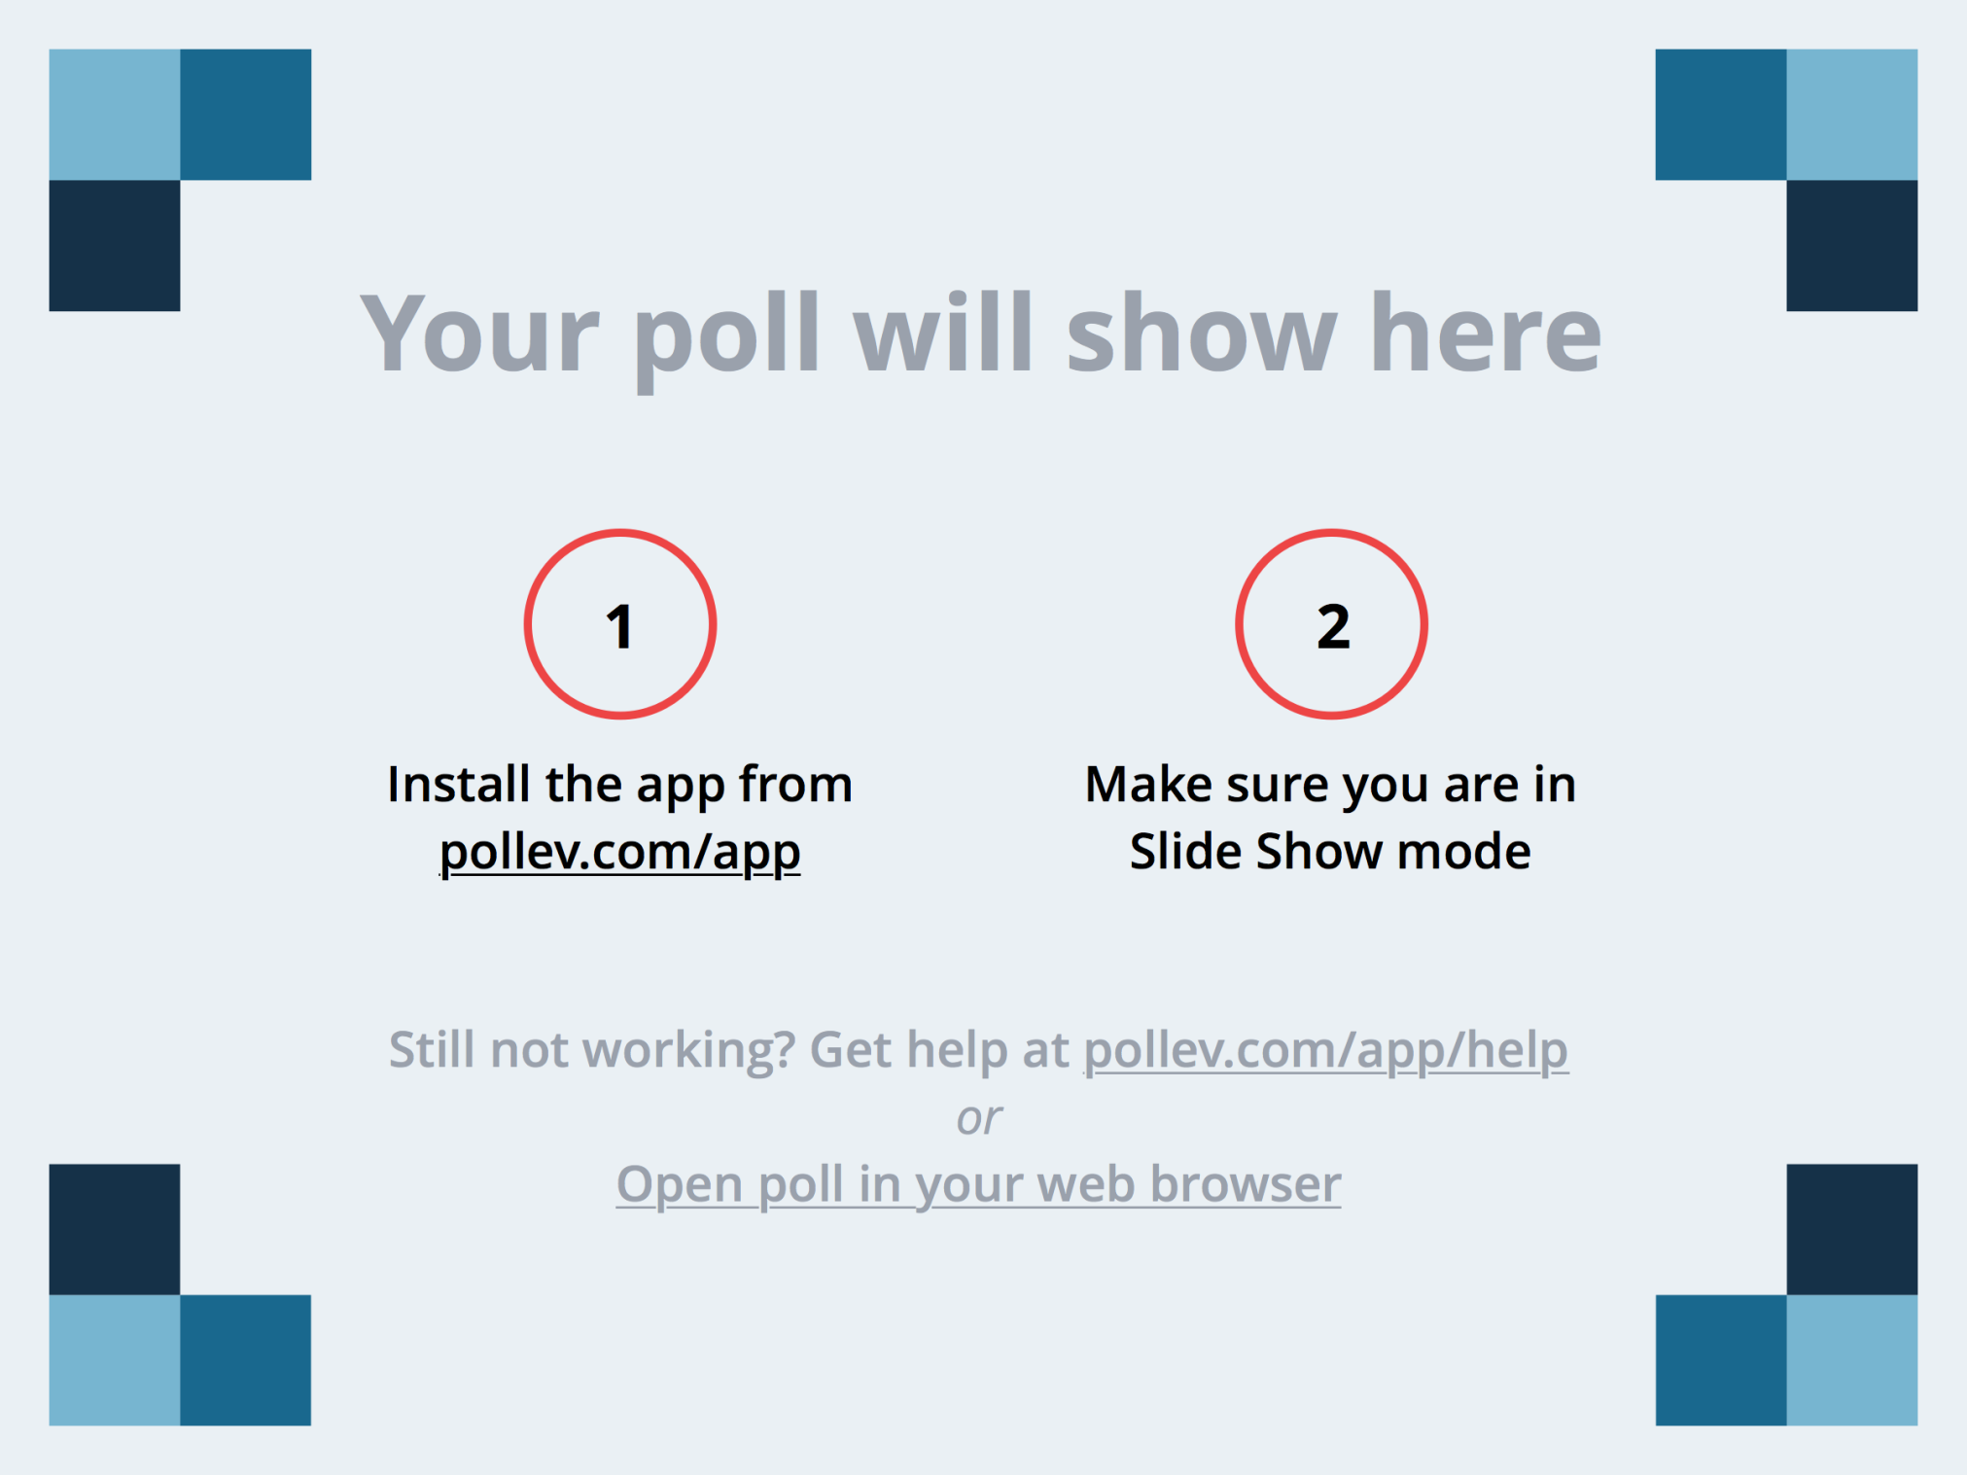
Notes:
What grade level do you teach? https://www.polleverywhere.com/multiple_choice_polls/aa6IKK1zzbLWV24

Slide 3
Notes:
How many years have you been teaching? https://www.polleverywhere.com/multiple_choice_polls/L5Ogu4ucFp2iT24

Slide 4
Getting to Know Your Group
Please Share:
Your Name
Your School
Read the Student Responses Handout. Share one that made you laugh out loud.
Notes:
Slide 2: Get-to-Know-You Activity
Provide PTT to Read the Funny Student Responses Handout (1-2 min)
Small Group Discussion to Share:
- Your Name
- Your School
- What You Teach or Your Role
- Share the Student Response that Made You Laugh Out Loud

Slide 5
Core Statements
Intelligence is not a fixed trait. It can be grown through effort and continued learning.
Students grow into the intellectual community that surrounds them.
Student engagement, questions, and curiosity are critical to all aspects of teaching and learning.
Inquiry-based learning experiences are fundamental to the learning of science.
Notes:
Slide 2: Get-To-Know-You Activity (5-8 min)
Briefly Share (1-2 min)
Talk with a partner about which one resonates with you the most (2 min)

Slide 6
Core Statements
Differentiation is not about lowering the standards, but rather providing access to or deepening the understanding of the standard.
Assessment and teaching are interdependent practices. Great teachers are perpetual students of their students’ thinking.
Notes:
Slide 2: Get-To-Know-You Activity (5-8 min)
Briefly Share (1-2 min)
Talk with a partner about which one resonates with you the most (2 min)

Slide 7
Structure of the Day
8:30-10:30 – Vertical Learning Cohorts
10:45-11:30 – Vertical Curiosity Groups
- Formative Assessment
- Differentiation
11:30-1:00 – Lunch
1:00-3:00 – Grade/Course Level Groups
3:00-3:30 – SLN Meeting
Notes:
Slide 4: Structure of the Day (1 minute)
Briefly go over the structure of the day (schedule).

Slide 8
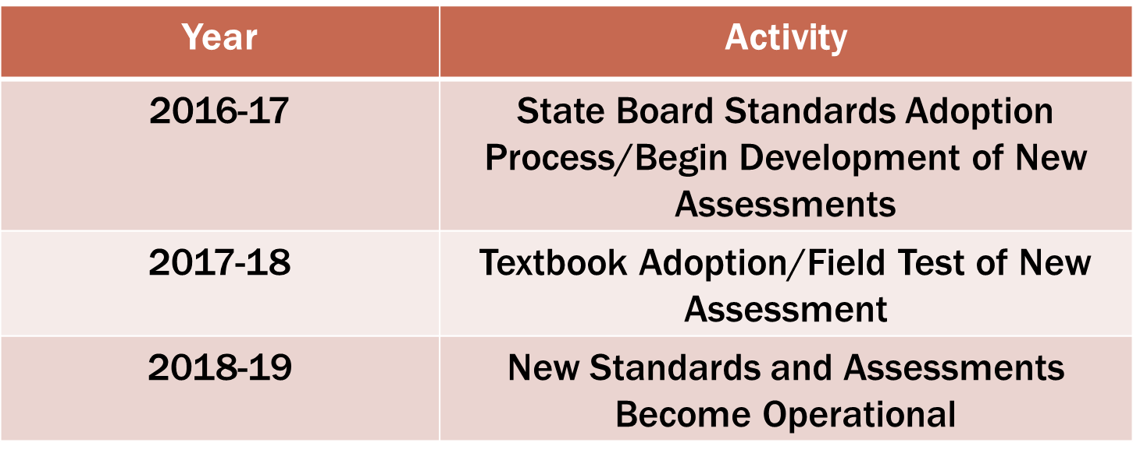
Reminders
Shared Norms
Important Moments Sheet
Notes:
Slide 5: Reminders (2-4 min)
Shared Norms (posted) - Be sure that the District Norms Poster is in a prominent place. Be sure that the District Norms poster is visible in the room. These were developed by the science teachers in district-wide PD last year. They will be our common norms at all district meetings and professional development. Encourage them to use them in their department and school meetings.
Memorable Moments Sheet - Briefly draw attention to the Reflections and Important Moments Sheet (Yellow Cardstock). This is to be used throughout the day for their notes/reflection. Although there will be a few set times to utilize this tool, encourage everyone to jot down things in the moment instead of just waiting for those times. Don’t forget to think about key times that you want them to use this document to reflect during your session.
New Standards Time Line – Emphasize new standards and assessments do not begin until 2018-2019. Current assessments will look like prior years. HS EOCs will still be timed 65 questions in 75 minutes.

Slide 9
Vertical Learning Cohort Goals
Share and discuss the essential questions that will direct our future learning.
Do some science together as learners and debrief the experience as teachers.
Notes:
Slide 6: Session Goals (1 minute)
Briefly go over the goals for this session

Slide 10
Essential Questions for Our Learning
How do I assure that inquiry-based learning experiences will help my students reach specific learning outcomes?
How can I formatively assess my students in ways that provide actionable data?
How can differentiation help me move all students toward a core science goal?
Notes:
Slide 7: Essential Questions for our Learning (3-5 min)
How do I assure that inquiry-based learning experiences will help my students reach specific learning outcomes?
How can I formatively assess my students in ways that provide actionable data?
How can differentiation help me move all students toward a core science goal?
Briefly describe the structure of our learning for the year. The first question will be our central question for all learning. The other two will help us achieve the first one and will be embedded in the general learning. Teachers will choose which question (2 or 3) that they want to investigate more. Interest groups will be formed during district in-service and throughout the year based on either formative assessment or differentiation.

Slide 11
Let’s Do Some Science!
Notes:
Slide 8: Engaging in Science as a Learner (60 min)
Select a Task from ADI that will promote high levels of engagement, inquiry, and curiosity. Only go through the first 5 stages. During the task utilize the following instructional practices:
- Accountable Talk (Structured Science Talk, Go-Around, 5
Talk Moves)
- Authentic Note-booking
- Public Record
- Selecting, Sequencing and Connecting Ideas

Slide 12
Debrief
Small Group Discussion:
How did the design of the task engage you as a learner?
Where and how did you experience the Habits during this lab?
What instructional practices kept the focus on learning?
Notes:
Slide 9: Debriefing the Lesson (20 min)
PTT to reflect on the discussion questions (2-3 min)
Small Group Discussion: (15 min)
- How did the design of the task engage you as a learner?
- Where and how did you experience the Habits during this lab?
- What instructional practices did the teacher use in the lesson?
Closure (2 min)

Slide 13
Reflection
Take a moment of PTT to reflect on the morning and record one or more take-aways for your practice.
Share one of your take-aways with a partner.
Notes:
Slide 10: Reflection on the Morning (5 min)
PTT to reflect on the morning (could use memorable moments sheet) (1-2 min)
Partner Talk sharing one take-away from the morning (2-4 min)

Slide 14
Next Steps
Read the two essential questions below.
Which one sparks your curiosity?
Which one do you want to investigate this year?
How can I formatively assess my students in ways that provide actionable data?
How can differentiation help me move all students toward a core science goal?
Notes:
Slide 11: Next Steps (5 min)
Briefly describe the next steps to the learning. Both the questions will help address our main essential questions. They will decide which question that they want to choose as a focus for their learning this year. There will be interest groups during the year and sessions in district PL.
PTT to think about the 2 questions.
Which one sparks your curiosity?
Which one do you want to investigate this year?
Have teachers write their choice on the appropriate colored notecard and leave it as their ticket-out-the-door. Assign them a number as they walk out of the door for the next session. This number will be used to assign rooms.

Slide 15
Notes:
Which session are you going to attend next? https://www.polleverywhere.com/multiple_choice_polls/bXGBGIwYLuEpPIY

